Slide 1

Part 5 Chapter 29-30
Network Secure And SNMP
Jin weizu
Jinweizu@tongji.edu.cn
13391355632

Slide 2

Part V-Chapter 29 Network Security
Criminal Activities In Internet
Internet crimes
Scams
Business Crimes
Identity theft
Damage to reputation
Loss of customer confidence
Stolen intellectual property
Prevention of customer access

Slide 3
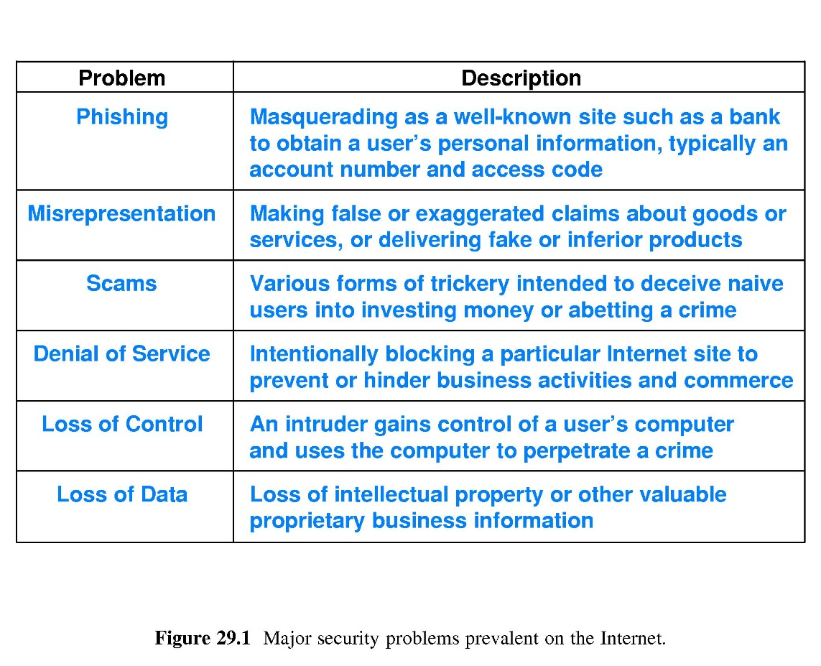
Part V-Chapter 29 Network Security
Major Security Problems on Internet

Slide 4
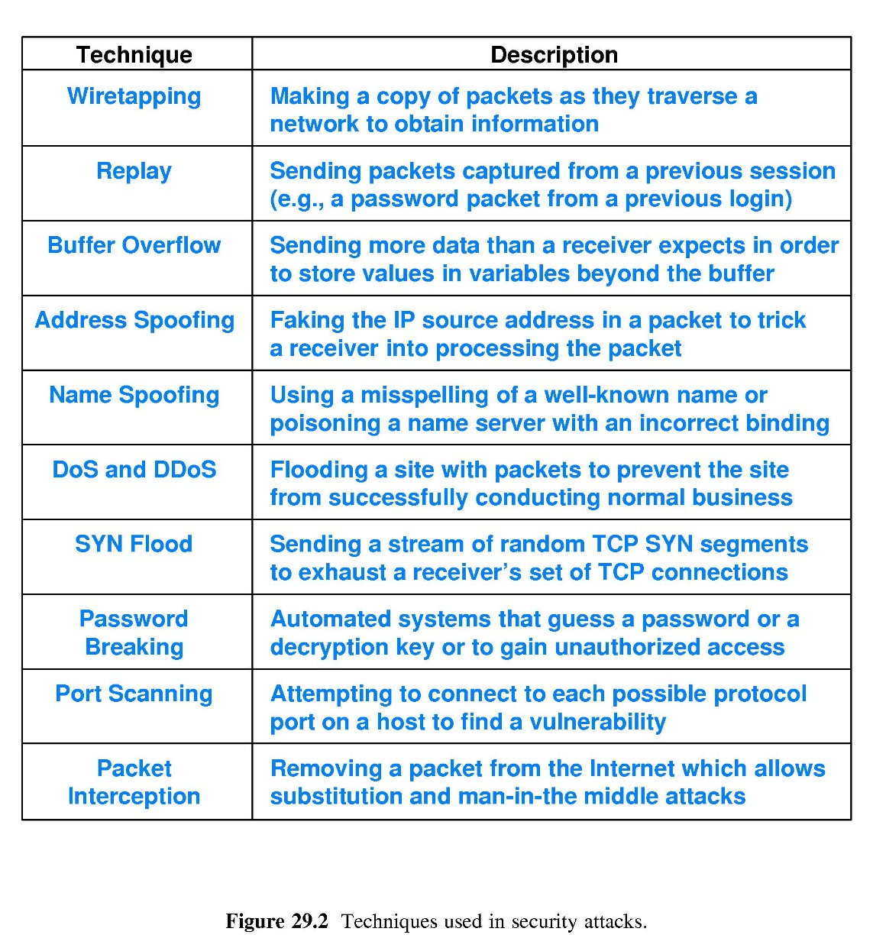
Part V-Chapter 29 Network Security
Techniques used in Security attacks

Slide 5
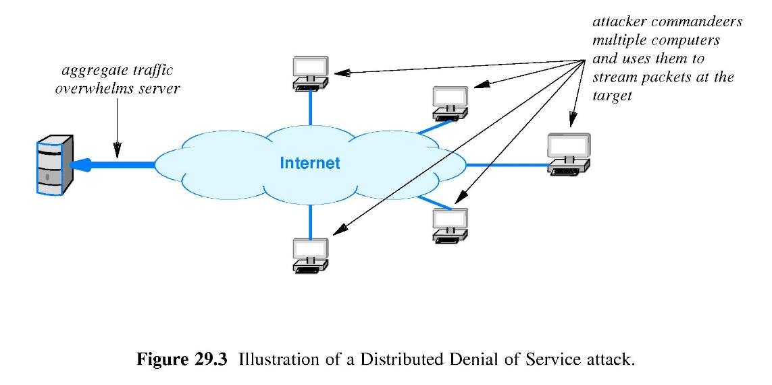
Part V-Chapter 29 Network Security
Distributed Denial of Service

Slide 6
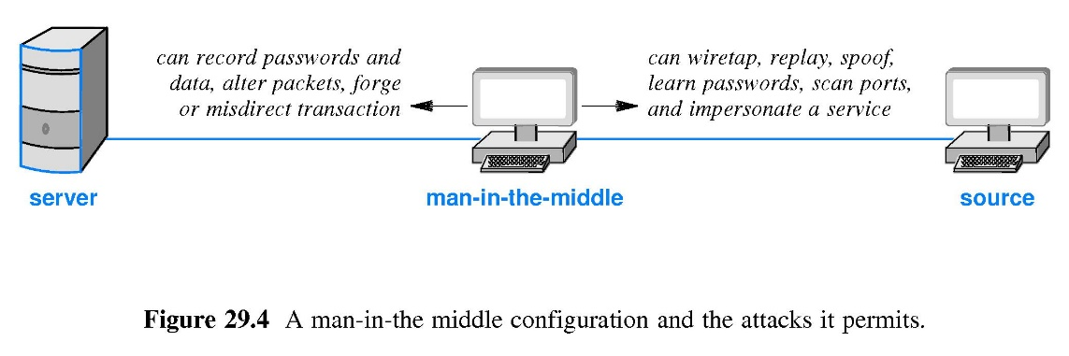
Part V-Chapter 29 Network Security
A man-in-the middle

Slide 7
Part V-Chapter 29 Network Security
Secure Network Definitions
It can prevent outsiders from accessing the organization’s computers
No absolute definition of secure network exists
It can allow arbitrary access to data，but prevents unauthorized changes
It is in which no one other than the intended recipient can intercept and read a message
It can allow access to selected data or service and prevents access or modification of sensitive data and service

Slide 8
Part V-Chapter 29 Network Security
Security Policy
The definition of security policy
It states clearly and unambiguously the items that are to be protected
The security policy for computer systems
The Complexities of Security Policy
Assessing the costs and benefits of various security policies also adds complexity
The security policy of human behavior
The security policy of network facilities

Slide 9
Part V-Chapter 29 Network Security
Aspects of Security
Data Integrity
It refers to protection from change
It refers to protection against disruption of service
Data Confidentiality
It refers to protection against unauthorized data access
It refers to the ability of a sender to remain anonymous
Data Availability
Privacy

Slide 10
Part V-Chapter 29 Network Security
Responsibility And Control
Accountability
It refers to how an audit trail is kept
It refers to responsibility for each item of information and how such responsibility is delegated to others
Authentication
It refers to validation of identity
Authorization
Responsibility
Control

Slide 11
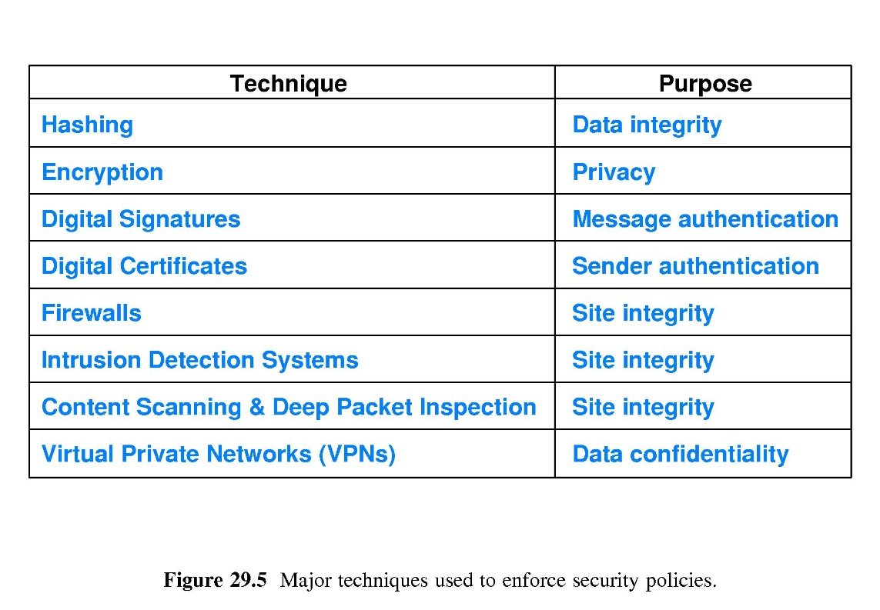
Part V-Chapter 29 Network Security
Major Security Technologies

Slide 12
Part V-Chapter 29 Network Security
Hashing Mechanisms
H=hash(key,message）
The sender
Cryptographic hashing Mechanisms
Message Authentication
The key is known only to the sender and receiver
H is a short fixed-length string and its length is independent of the message size
The receiver
Uses a secret key to compute a hash of the message as H
Transmits H along with the message
Uses the same key to compute a hash of the message received
If the hash be equal to H, the message has arrived intact
Based on one-way hashing algorithm, H cannot be converted back into the message

Slide 13
Part V-Chapter 29 Network Security
Hashing
A Message Authentication Code (MAC)
It cannot be broken and forged by an attacker
Data Integrity against intentional change
Without the key, the message will introduce an error while it is modified
The hashing value(Key) can represents the original message
Replace channel coding with hash while transmission
It make sure that every byte has an impact on the final result

Slide 14
Part V-Chapter 29 Network Security
Hashing algorithms
MD4
MD5
SHA1
SHA256
Message Digest
It products a 128-bit hash
It products a 160-bit hash
It products a 256-bit hash
RFC 1320
RFC 1321

Slide 15
Part V-Chapter 29 Network Security
Access Control
An attacker makes automate attempts to break a password
Access Control List
Password
It specifies who is allowed to access each object
Using password with a Verification Code
It controls which users or application can access data
Wiretapping is especially easy when packets travels multi-access network

Slide 16
Part V-Chapter 29 Network Security
Cryptography
Substitution cipher
Permutation cipher
a,b,c,d→d,e,f,g
CIPHER→145326
attack begins at two→aacttk binges aw ott
attack begins at two→dwwdfn ehjhlv dw wzr
Encryption
It scrambles bits of the message in such a way that only the intended recipient can unscramble them

Slide 17
Part V-Chapter 29 Network Security
The Terminology Used With Encryption
An original message before it has been encrypted
Cyphertext
An message after it has been encrypted
A short bit string used to encrypt a message
Encryption key
Plaintext
Decryption key
A short bit string used to decrypt a message
Key
Features
The key cannot be deduced from the cryptography algorithm and plaintext and cyphertext
The key can only be obtained on the exhaustive method

Slide 18
Part V-Chapter 29 Network Security
Encryption Functions
C=encrypt(K1，M)
Function encrypt produces an encrypted version of the message
K1 donates an encrypt key
C donates a cyphertext
M=decrypt(K2，C)
Function decrypt reverses the mapping to produce the original message
K2 donates a decrypt key
M donates a plaintext

Slide 19
Part V-Chapter 29 Network Security
Private Key Encryption System
Single key served as both an encryption key and decryption key
C=encrypt(K，M)
Symmetric Encryption
It is suitable for the large message
K donates a key
M donates the plaintext
C donates the cyphertext
M=decrypt(K，C)
DES algorithm
按64位进行分组，明文和密文的长度相同

Slide 20
Part V-Chapter 29 Network Security
Public Key Encryption System
Private key is kept secret
M=decrypt(prv-u1，encrypt(pub-u1，M))
Asymmetric Encryption
M=decrypt(pub-u1，encrypt(prv-u1，M))
Public key is published along with the name of the user
M donates the plaintext
pub-u1 donates user 1’s public key
It is suitable for the small message
prv-u1 donates user 1’s private key

Slide 21
Part V-Chapter 29 Network Security
Asymmetric Encryption algorithm
RSA algorithm
Published in1977 by Ron Rivest, Adi Shamir and Leonard Adleman
ECDHE algorithm
ECDH algorithm
DH algorithm
DHE algorithm

Slide 22
Part V-Chapter 29 Network Security
RSA algorithm
Two prime number p and q which need to be very large, and also relatively far apart
n=p*q
Carmichael’s totient function
modulus n
λ(n)=lcm(p-1,q-1)
Lcm means the lowest common multiple
Generating public key E
E is a random prime number between 1 and λ(n)
C=M^{^E} mod n
M donates the plaintext；
C donates the cyphertext
Generating private key D
D=1/E mod λ(n)
M=C^{^D} mod n
Generating primes

Slide 23
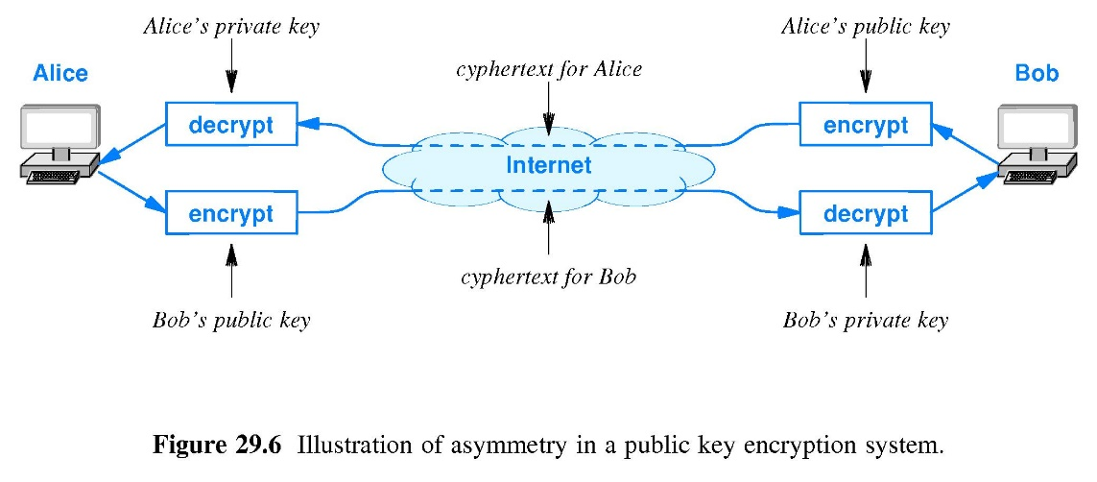
Part V-Chapter 29 Network Security
Public Key Encryption System
C=encrypt(pub-u1，M))
Communication with Data Confidentiality
A sender uses the receiver’s public key to encrypt the plaintext as C and sends C
Only the receiver can decrypt the cyphertext with its private key
M=decrypt(prv-u1，C)

Slide 24
Part V-Chapter 29 Network Security
Digital Signature With Public Key
It can be used to authenticate the sender of a message
Digital Signature
The sender encrypts the message using sender’s private key to sign the message
The receiver looks up the sender’s public key and uses it to decrypt the message to verify the signature
X=encrypt(prv-send，M)
M=decrypt(pub-send，X)
It can authenticate that the message had been signed by the sender because only the sender has the private key needed to perform the encryption
Digital Signature Process

Slide 25
Part V-Chapter 29 Network Security
Both Authentication And Confidentiality
Let’s u1 donates the sender，u2 donates the receiver
X=encrypt(pub-u2，encrypt(prv-u1，M))
The message is encrypted by using the sender’s private key to sign it
The Receiver
The signed message is encrypted again using the receiver’s public key
M=decrypt(pub-u1，decrypt(prv-u2，X))
The sender
The encrypted message is decrypted using the receiver’s private key
The signed message is decrypted again using the sender’s public key

Slide 26
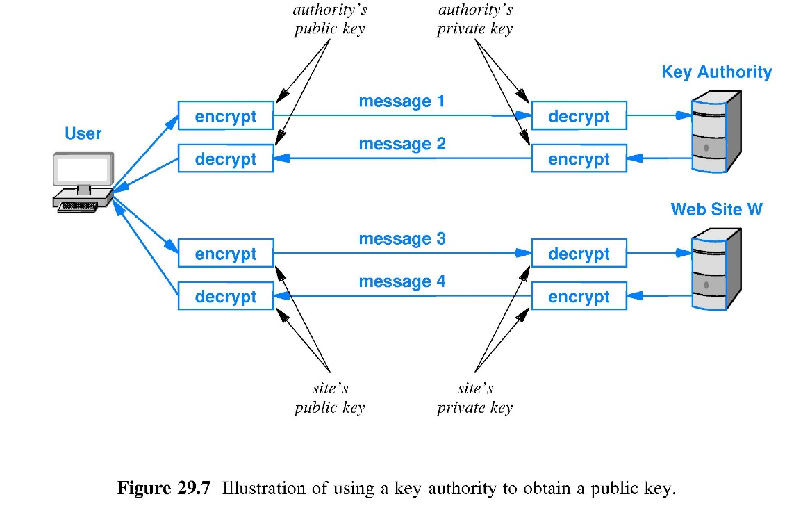
Part V-Chapter 29 Network Security
Obtain A Public Key
Certificate Authority
It distributes the key
Key Authority
User applies to CA for W’s public key
Message1 contains the application message using authority’s public key
Message2 contains W’s public key using authority’s private key
User and W site use W’s keys to transfer message each other
message3 decryted by W’s public key
message4 encryted by W’s private key

Slide 27

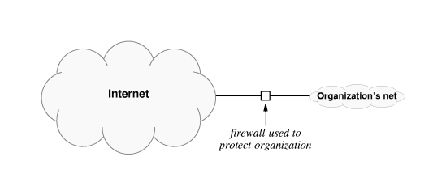
Part V-Chapter 29 Network Security
Firewall
Firewall
Internet Firewall
The most important security tool used to handle the connection between two organizations that do not trust each other
It helps protect an organization’s computers and networks from unwanted traffic
It can lower the cost of providing security
It is placed between two parts of a structure to prevent fire from moving between them

Slide 28
Part V-Chapter 29 Network Security
Usage of Internet Firewall
It centralizes control to implement security policies
All traffic entering the organization passes through the firewall
The firewall implements the security policy and rejects any traffic that does not adhere to the policy
The firewall itself is immune to security attacks
All traffic leaving the organization passes through the firewall

Slide 29
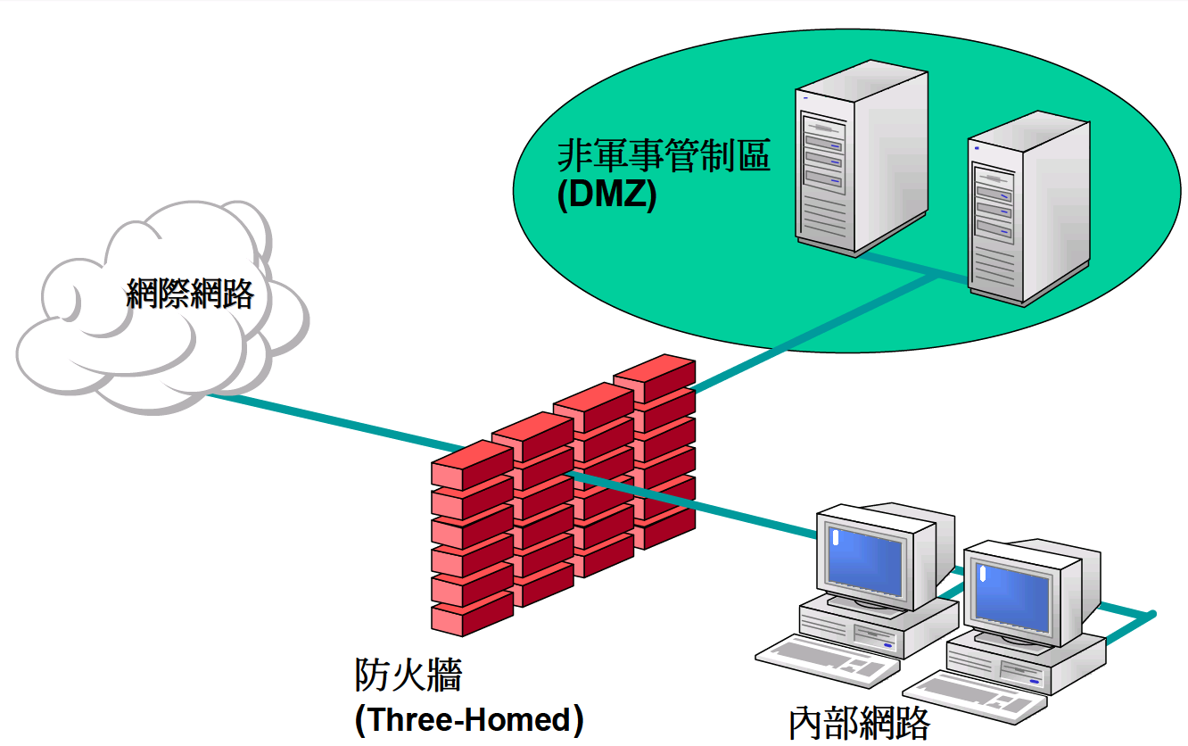
Part V-Chapter 29 Network Security
The Architecture of Internet Firewall
The secure hosts
Inner net
Outer net
Organization Intranet
Other organization Intranet
Internet
DMZ(Demilitarized Zone)

Slide 30
Part V-Chapter 29 Network Security
Firewall Mechanism
Packet filter
It specifies which IP datagrams are permitted to pass through the router and which should blocked
It operates by examining fields in the header of each IP datagram
The Additional Functions of the Packet Filter
A packet filter can examine the protocol in the packet or the service to which the packet corresponds
A packet filter can specify complex combinations of IP addresses and service port

Slide 31
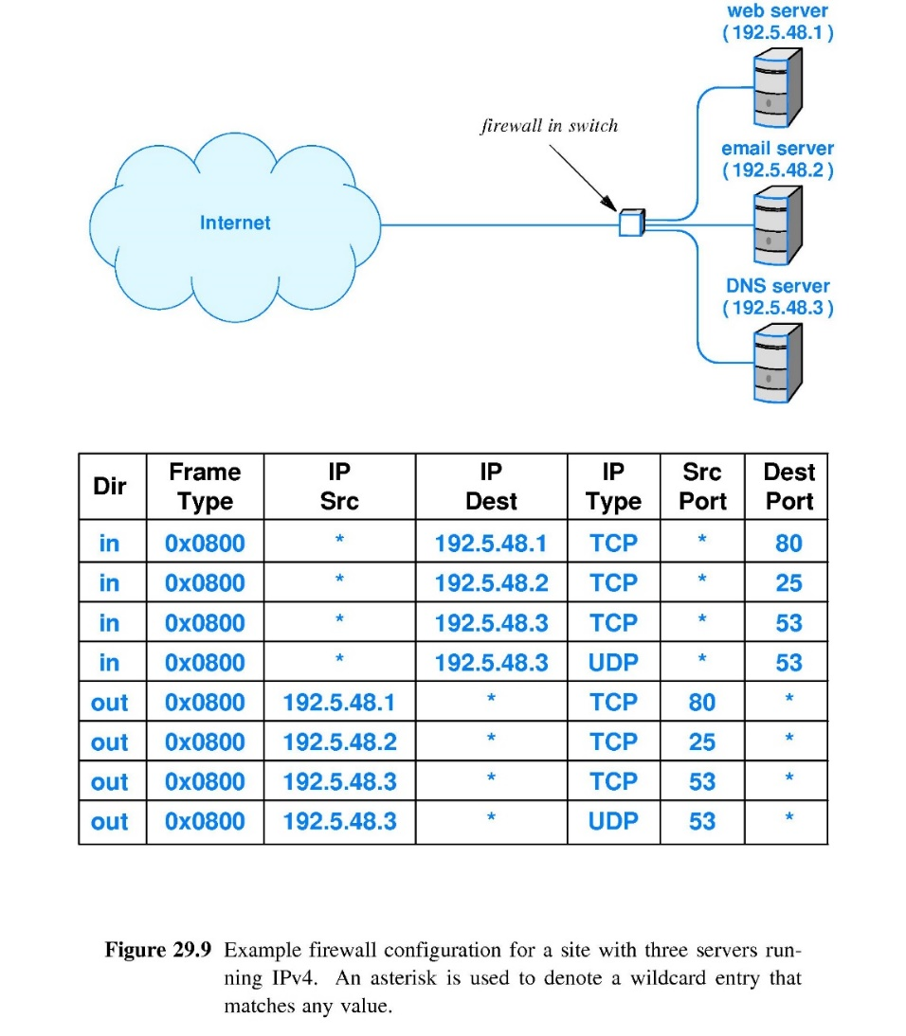
Part V-Chapter 30 Network Security
Example Firewall Configuration
A packet filter specification
It permits the services of HTTP, SMTP and DNS

Slide 32
Part V-Chapter 29 Network Security
Intrusion Detection Systems(IDS)
IDS
It monitors all packets arriving at a site
It provides an extra layer of security awareness and can notify the site administrator that a problem is occurring
IDS Mechanism
It cannot handle as many packets per second
It watches for specific types of attacks
It is placed on the bypass by using the mirror function of switch

Slide 33
Part V-Chapter 29 Network Security
Content Scanning
File scanning
A software is installed on a PC
It takes a file as input and looks for patterns of bytes known as a fingerprint
Deep Packet Inspection
It operates on packets instead of files
It examines not only the header but also the data in the packet
Many viruses have their character strings of bytes
It is limited to lower-speed networks

Slide 34
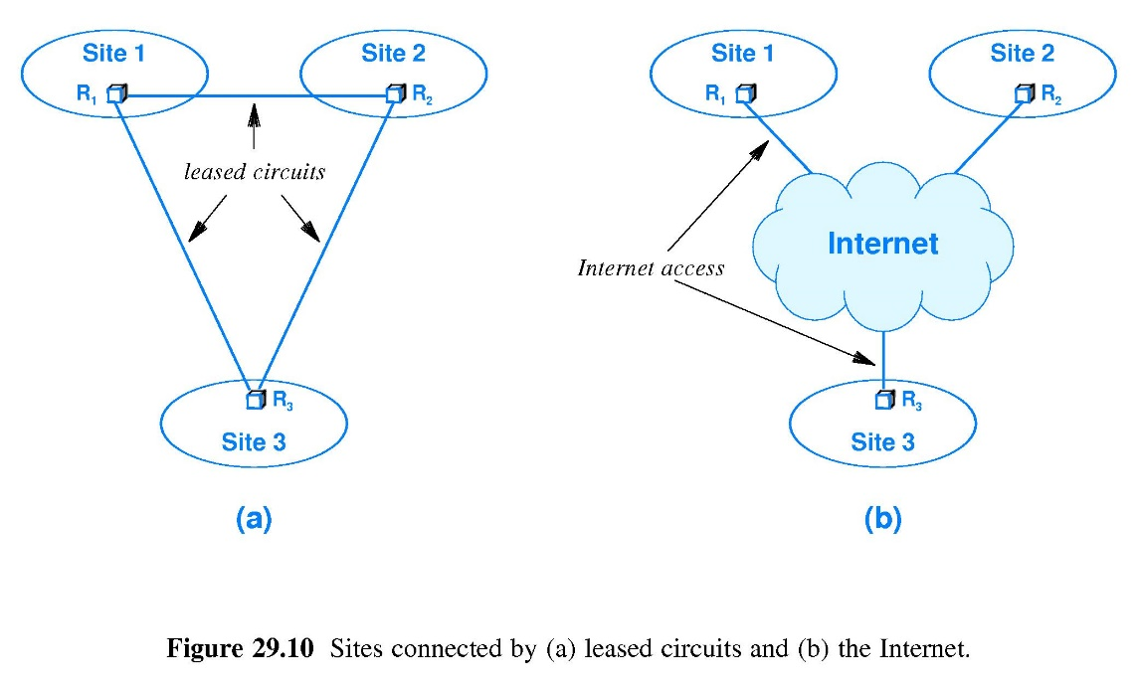
Part V-Chapter 29 Network Security
Intranet Connections
Private Network Connection
Leased connection
Public Internet Connection
Internet access
High confidentiality
Low confidentiality
High cost
Low cost

Slide 35
Part V-Chapter 29 Network Security
Virtual Private Networks(VPN)
All packets are encrypted before being sent
Stand-alone device
VPN Software
VPN Hardware
Forms of VPN
It runs in the user’s personal computer
A combined approach
Using Public Internet Connection

Slide 36
Part V-Chapter 29 Network Security
Packet Encryption Of VPN
Payload Encryption
IP-in-IP tunneling
It encrypts the payload area of a datagram
All fields in the original datagram are encrypted
IP-in-TCP Tunneling
They transit encrypted datagrams by using TCP connection
But it does not encrypt the header of a datagram
They transit encrypted datagrams by using IP communication
Two parties establish a TCP connection

Slide 37
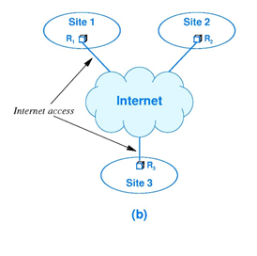
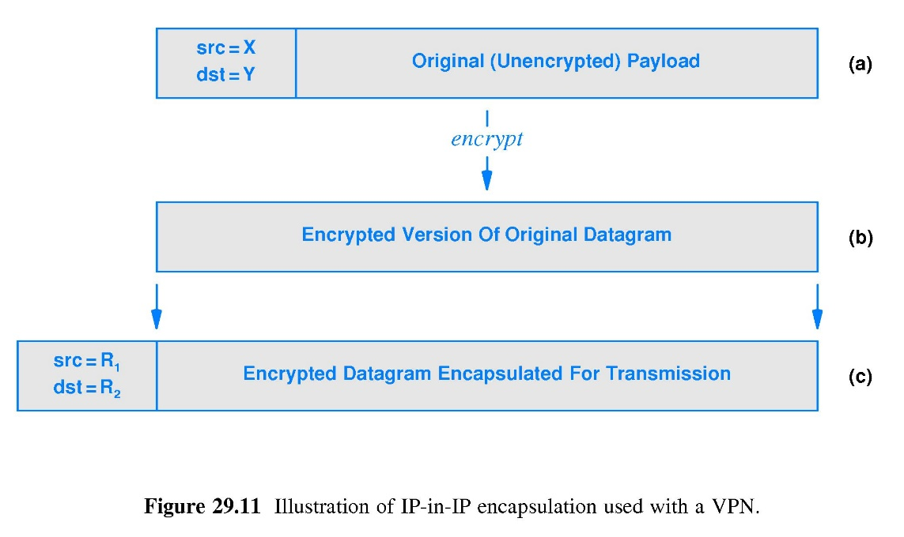
Part V-Chapter 29Network Security
VPN Using IP-in-IP Tunnel
When it encounters an outgoing datagram from X in site 1 to Y in site 2, It encrypts entire datagram
VPN on router R2
It forwards the original datagram to Y
It decrypts the payload to extract the original datagram
It encapsulates encrypted datagram in a new datagram across the IP-in-IP tunnel from R1 to R2
VPN on router R1
Communication with private addresses
X in Site 1
Y in Site 2

Slide 38
Part V-Chapter 29 Network Security
VPN Using IP-in-IP Tunnel
Suitable for any application protocol
VPN on PC
VPN Software
Advantages
Enterprise VPN
TCP
UDP

Slide 39
Part V-Chapter 29Network Security
VPN Using IP-in-TCP Tunnel
When it encounters an outgoing datagram from X to Y , It encrypts entire datagram
VPN Server
It processes the original datagram with proxy X and Y
It decrypts the payload to extract the original datagram
It encapsulates encrypted datagram in a new datagram across the IP-in-TCP Tunnel
VPN Client
Setup an IP-in-TCP Tunnel
VPN Client and VPN Server establish a TCP connection in advance

Slide 40
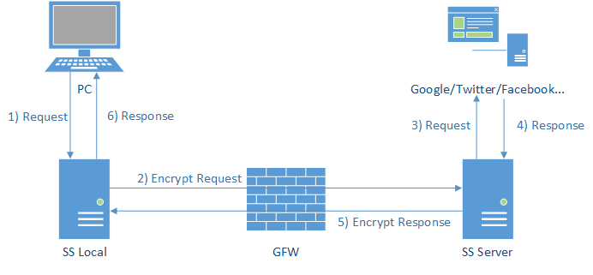
Part V-Chapter 29 Network Security
VPN Using IP-in-TCP Tunnel
Before sending, The request and response are encrypted
VPN Server
It interacts with the target website
The encrypted request and response are transmitted between VPN Client and VPN Server
Communication across IP-in-TCP Tunnel
Browser
It interacts with to local proxy server as VPN client
After receiving, The request and response are decrypted

Slide 41
Part V-Chapter 29 Network Security
Security Technologies
Pretty Good Privacy(PGP)
Secure Shell(SSH)
Secure Socket Layer(SSL)
A cryptographic system that application can use to encrypt data before transmission
An application-layer protocol for remote login by encrypting data
It uses encryption to provide authentication and confidentiality
Transport Layer Security(TLS)
A successor to SSL

Slide 42
Part V-Chapter 29 Network Security
Security Technologies
IP Security(IPsec)
HTTP Security(HTTPS)
It combines HTTP with either SSL or TLS by using TCP port 443
It may encrypts the datagram payload
Remote Authentication Dial-In User Service（RADIUS）
A protocol used to provide centralized authentication, authorization and accounting
Wired Equivalent Privacy（WEP）and Wi-Fi Protocol Access(WAP)
It is used to keep transmission confidential
It may validate the datagram’s sender and recipient

Slide 43
Part V-Chapter 30 SNMP
Network Management in Intranet
A network manager
Installing, operating, monitoring and controlling the intranet
planning a network that meets performance requirements
A computer network or Intranet failures
Hardware failures
Software failures

Slide 44
Part V-Chapter 30 SNMP
Network Management
The intranet is heterogeneous
Some parts are remote
New devices and new services appear constantly
The Reasons of Network Failures
The Property of Network Failures
The most severe failures may be the simplest to diagnose
Intermittent or partial failures may be a difficult challenge

Slide 45
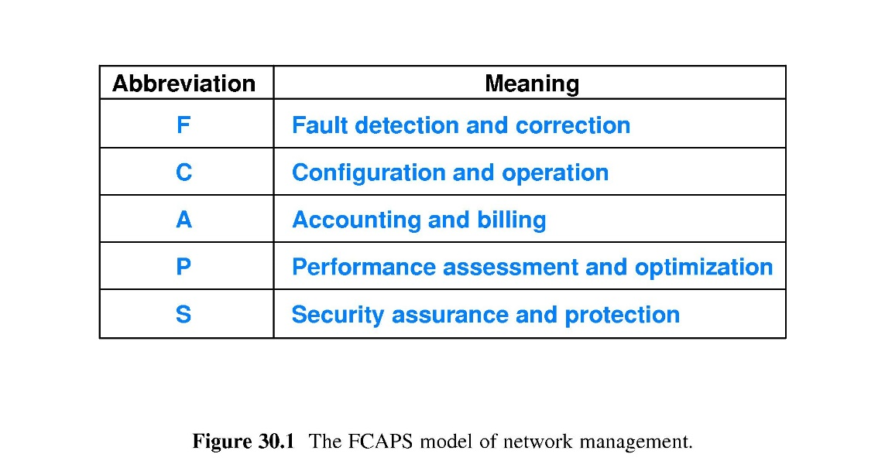
Part V-Chapter 30 SNMP
FCAPS Work Model
M.3400 published by International Telecommunications Union(ITU)
The industry Standard Model

Slide 46
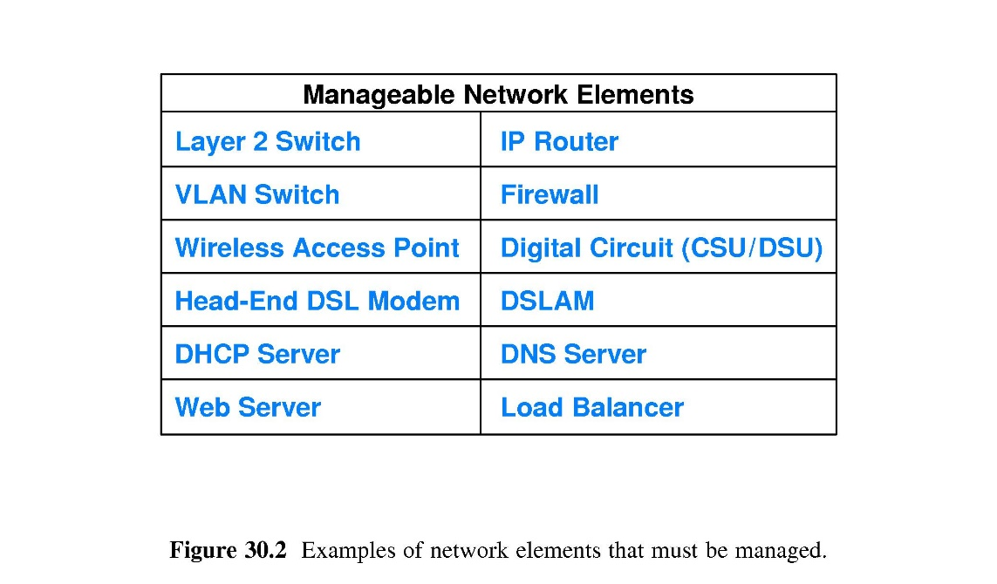
Part V-Chapter 30 SNMP
Network Elements
Network device
System
Mechanism
Switch
Router
DNS Server
Load Balancer
Web Server

Slide 47
Part V-Chapter 30 SNMP
Network Management Tools
Network Discovery Tool
Performance monitoring
Plot performance over time
Physical Layer Testing
Ping program
Packet analyzer
Carrier sensor testing
Capture and display packets
Tcpdump
produce a map of the network by probing device
Event monitoring tools
produce and display alerts

Slide 48
Part V-Chapter 30 SNMP
Network Management Tools
Flow Analysis Tool
Routing and Traffic Engineering
Configuration
Security Enforcement
Network Planning
Spot changes in specific types of traffic
Test security
Specify a policy and configure device enforce the policy
Control the configuration and monitoring of routing
Automate the repetitive task of making a change in a set of elements

Slide 49
Part V-Chapter 30 SNMP
Network Management Application
The communication between the network manager tool and the given network element
Not define as an integral part of low-layer protocol
Used to monitor and control network devices operate at the application level
Simple Network Manager Protocol
Using UDP as transport protocol

Slide 50
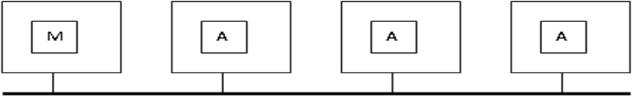
Part V-Chapter 30 SNMP
Simple Network Manager Model
Network Manager
Network Agent
It acts as a server
An application program runs on the management stations
It can be used to monitor and control network components
An application program runs on the network device
It acts as a client

Slide 51
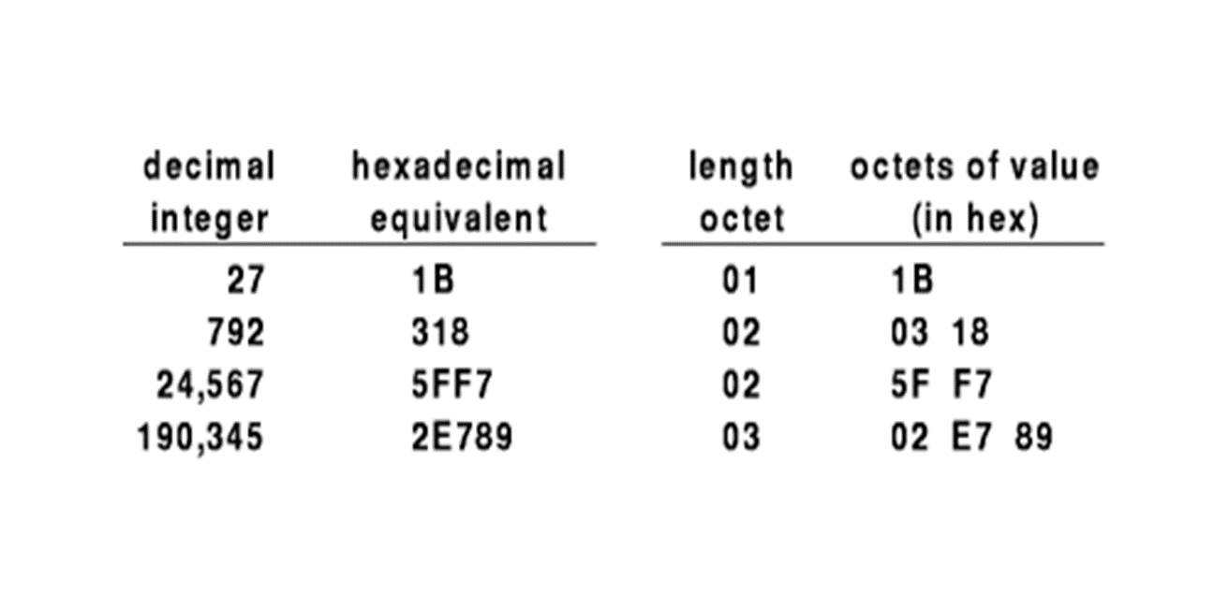
Part V-Chapter 30 SNMP
Simple Network Manager Protocol
SNMP Message Format
Encoded using a standard known as Abstract Syntax Notation.1
A combination of length and value for Network object

Slide 52
Part V-Chapter 30 SNMP
SNMP Operations
Fetch operation
Store operation
set-request command
get-request command
get-next-request command
It is used to obtain a value from a device
It is used to set a value in a device

Slide 53
Part V-Chapter 30 SNMP
SNMP Object Names
Management Information Base(MIB)
The set of all objects SNMP can access
New MIB object can be defined
It is specified by other standard, not SNMP

Slide 54
Part V-Chapter 30 SNMP
SNMP Object Names
MIB Variable
A long prefix that guarantees the name will be unique
Example
iso.org.dod.internet.mgnt.mib.ip.ipInReceives
1.3.6.1.2.4.3
The number of IP datagrams a device has received

Slide 55
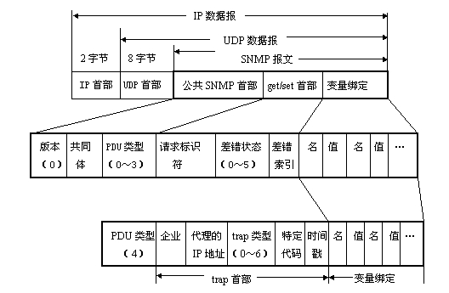
Part V-Chapter 30 SNMP
SNMP Message
PDU
0:get-request
1:get-next-request
3:set-request
4:trap
2:get-response

Slide 56
Part V-Chapter 30 SNMP
SNMP MIB Variables
New MIB variables can be defined and standardized as needed without changing the basic protocol
Protocols such as UDP，TCP，IP and ARP have been created
Hardware such as Ethernet、Token Ring，FDDI have been created
Standard MIB prefix.ip.ipRouting Table
Standard MIB prefix.ip.ipRouting Table.ipRouteEntry.field.Ipdestaddr
snmputil walk localhost public .1.3.6.1.4.1.77.1.2.25.1.1
Examples of MIB Variables

